Slide 1
Responsible AI

Slide 2
Principles
Principle | Definition (per Microsoft) | Mechanical Engineering Example | Implementation Considerations
Fairness | Treat people and groups equitably, mitigating bias | AI quality control in manufacturing | Balanced datasets, audit disparate impact
Reliability and Safety | Operate reliably, safely, and consistently under all conditions | Predictive maintenance for CNC machines | Robust testing, stress scenarios, overrides
Privacy and Security | Uphold strong security and privacy protections for all data and AI behaviors | Digital twins in smart factories | Encryption, access control, anonymization
Inclusiveness | Design to benefit diverse backgrounds and abilities | Adaptive AI robot interfaces | Participatory design, accessibility
Transparency | Systems are understandable; decisions are explainable | Explainable AI for design optimization | Model documentation, XAI toolkits
Accountability | Clear lines of human oversight and recourse for AI outcomes | Audit trails in process control automation | Audit logs, responsible parties, override

Slide 3
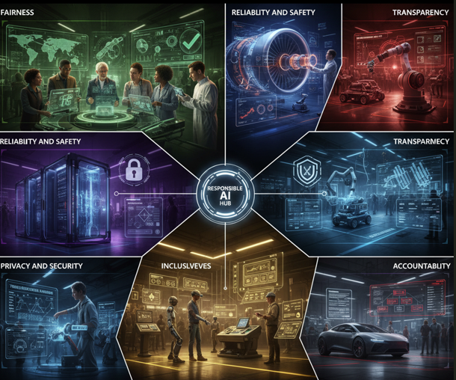

Slide 4
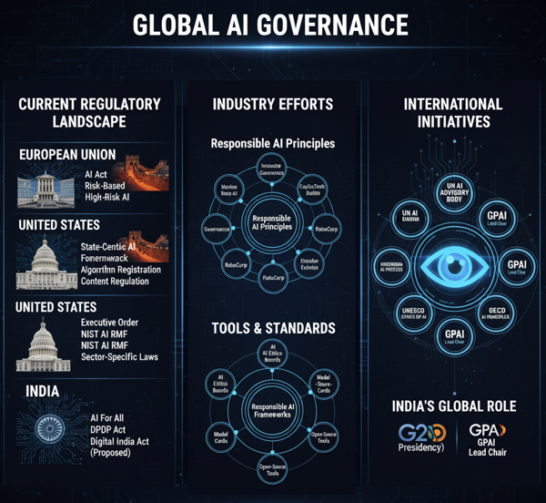

Slide 5
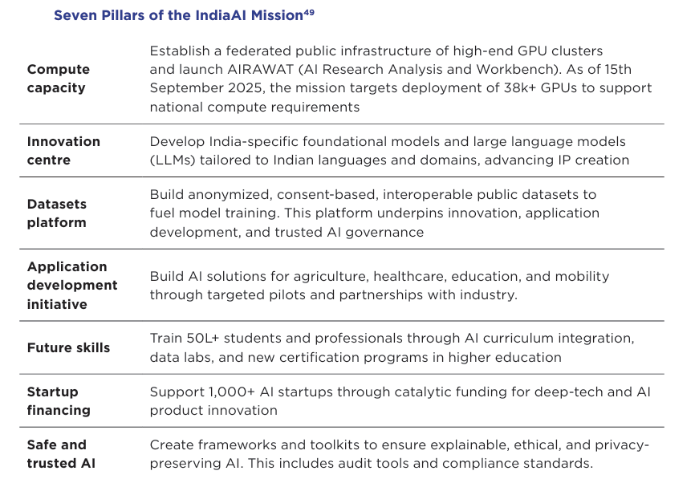
India AI mission

Slide 6
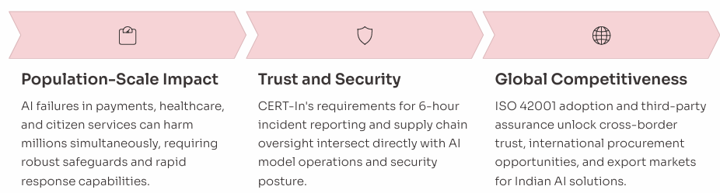
Pillars of adoption

Slide 7
Regulatory Interventions
The approach document Principles for Responsible AI1 notes that various considerations and risks with AI systems already find an expression in the Constitution of India and existing laws. Specific rules and regulations may need to be augmented to include the AI/ML-specific risks. In addition, the growth of AI has been relatively recent and approaches to govern AI systems are still evolving in most parts of the world. India has also seen AI-specific regulatory interventions and, in certain cases, existing regulations define the expectations from AI systems.
The NSAI identified the lack of ethical regulations as being a key barrier for AI adoption. For instance, clarity around doctor-patient confidentiality, the informed consent process, explainability standards and liability framework are a few of the areas in which the Government may consider enabling AI innovators in the digital healthcare industry
Approaches to regulate AI systems must aim to protect individual rights while promoting innovation. A one-size-fits-all approach to AI regulation, by design, is not feasible as the risks depend on the given use case and context in which it is deployed. An evolving, risk-based approach is needed to encourage innovation and safeguard the consumer and citizen interests. Various bodies around the world are exploring regulatory mechanisms on similar lines.
When assessing the potential for harm, the sociotechnical system as a whole must be considered. All components of an algorithmic application, including the people involved, from the design phase through to its implementation in an application environment and any evaluation and adjustment measures, should be assessed.20 The assessment of risk must also take both the direct and indirect impact of the system into consideration and may be done through policy instruments like sandboxing.

Slide 8
Policy Making
Manage and update the Principles for Responsible AI in India
Research into technical, legal, policy and social aspects of responsible AI in India
Enable access to data, responsible AI tools and techniques
Develop India’s (and other emerging economies’) perspectives on responsible AI

Slide 9
Procurement
Initiatives like having model documents have greatly eased the procurement process, especially in the infrastructure sector. The Government e-Marketplace (GEM) portal has further helped in enhancing the transparency in the procurement system, thereby, establishing groundwork for trust mechanisms.
Initiatives like evolving model procurement mechanisms and documents need to be pursued proactively to guide the overall process of procurement and ensure that the interventions are transparent and unambiguous. The issue of liabilities if AI is used in violation of the principles must also be addressed in procurement documents. 3.45. Depending on use case and deployment specifics of the proposed AI (or emerging technology) project, an institutional mechanism, similar to expert advisory committees that are constituted for complex projects, may be formulated to ensure that proposed projects are designed, developed and operated in adherence to the responsible AI principles. The composition of this body may include experts relevant for the use case- such as computer science, data science and machine learning experts, domain experts, legal experts, social science experts

Slide 10
Awareness and capacity building
Government may curate awareness initiatives on AI not only to provide perspectives on the capabilities but also highlight the weaknesses of AI systems and the need for responsible AI practices. Academic experts, industry bodies and independent organizations may be leveraged for needs assessment, development of training curriculum and conduct training programs for public sector officials.
The objectives of these programs may include: Raising awareness of capabilities of AI in order to ensure that the expectations from AI are practical and the supporting factors for the success of AI initiatives are well understood Underlining the need for responsible AI for promoting investment into responsible AI practices Showcasing industry practices for responsible AI, including governance systems, tools and processes Identifying and facilitating the availability of datasets, policy measures and other instruments needed to enable responsible AI in India Reducing information asymmetry, trust issues and apprehensions of AI systems and develop skills to identify and think through ethical problems

Slide 11
AI for Viksit Bharat
Artificial Intelligence (AI) systems have gained prominence over the last decade due to their vast potential to unlock economic value and help mitigate social challenge.
It is estimated that AI has the potential to add USD 957 billion, or 15 percent of current gross value added to India’s economy in 20351. It is projected, that the AI software market will reach USD 126 billion by 2025, up from USD 10.1 billion in 2018.
The cornerstone of AI implementation at Mahakumbh 2025 is an extensive surveillance network comprising over 2,700 CCTV cameras, with approximately 500 AI-enabled cameras specifically designed for real-time crowd analytics. This represents the first time artificial intelligence has been used for crowd management at such a massive scale globally.
At its current growth rate of 5.7%, India’s GDP is projected to reach $6.6T by 2035. However, under the aspirational 8% growth trajectory outlined in the government’s vision for the nation known as Viksit Bharat, India’s GDP could increase to $8.3T, representing an incremental $1.7T compared with the current growth path.

Slide 12
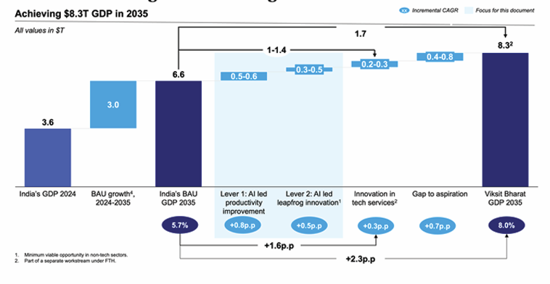
Potential AI opportunities in India
Accelerating AI adoption across industries to improve productivity and efficiency, potentially bridging 30–35% of the gap.
Transforming R&D, through generative AI, could help India leapfrog into innovation driven global opportunities, bridging a minimum 20–30% of the gap.
Innovation in technology services, strengthening India’s reputation as a technology services leader, contributing another 15-20% to the step up.

Slide 13
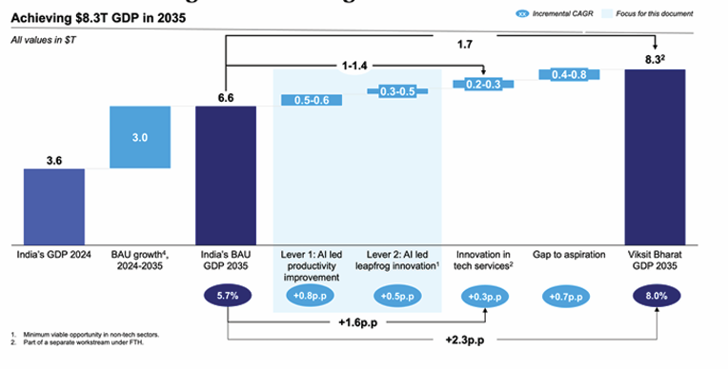

Slide 14
Strategic Enablers
Access to critical AI infrastructure such as cloud platforms, compute, and foundational datasets could help strengthen India’s sovereign AI capabilities. At the same time, robust AI governance frameworks, including ethics guidelines and risk controls, could ensure responsible and secure deployment.
The private sector can lead the scaling of AI adoption by embedding AI into core industry processes. This includes driving model validation, secure deployment, and AI powered decision-making, while maintaining resilience and accountability at leadership levels. Reskilling senior executives and upskilling the broader workforce would be key to enabling this transformation.
Academia can be vital in anchoring research and supporting large-scale workforce transformation. The creation of AI testing sandboxes can further enable safety and scale.
To ensure inclusive growth, it is essential to provide equitable access to AI resources and opportunities, particularly for MSMEs and economically underrepresented regions

Slide 15
ACCELERATING AI ADOPTION ACROSS INDUSTRIES
Baseline employment and GDP data: Used 2022 as the baseline year for both employment and real GDP, sourced from IHS. Calculated productivity as GDP per worker to set the reference point for future projections
AI adoption rates for 2035: Estimated sector-level AI adoption rates using McKinsey Global Institute’s (MGI) model, covering about 850 occupations and 2,100 activities with sectoral nuances. Applied these AI adoption rates to baseline employment to determine workforce segments likely to be automated
Growth rates across different scenarios: Augmented workforce calculated by redeploying the automated workforce at current productivity levels. New GDP projected by applying 2022 productivity to the augmented workforce. This yielded GDP CAGR over 2022–2035, forming the basis of Lever 1 sectoral projections

Slide 16
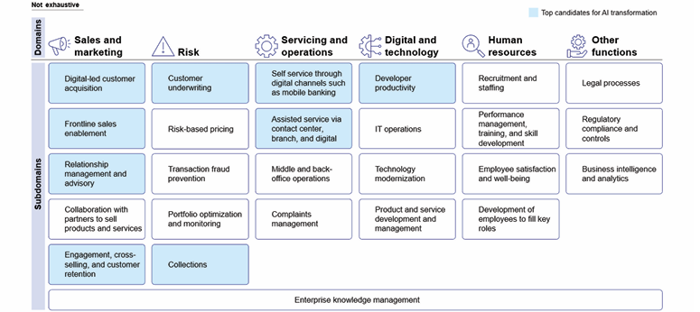
Banking

Slide 17
Banking
Financial services companies’ front, middle and back offices are expected to be transformed by machine learning and agentic AI. While the map represents important opportunities across domains, areas with potentially the highest ROI have been highlighted
In the back office, AI could power automated compliance, fraud detection, and risk management through advanced anomaly detection techniques and privacy-preserving analytics such as secure multi-party computation and federated learning
In the middle office, AI-enabled systems can reshape credit decisioning, collections, and portfolio management. By leveraging alternative data sources, banks can make more accurate, dynamic, and inclusive lending decisions
In the front office, virtual relationship managers can deliver hyper-personalized customer experiences. Using real-time behavioral predictions, these AI agents can offer tailored financial advice, timely product recommendations, and proactive outreach, helping deepen customer engagement and improve satisfaction across segments

Slide 18
Manufacturing
AI can unlock productivity and efficiency across multiple dimensions by lowering the cost of production, improving output yields through enhanced process efficiency, and increasing throughput via predictive maintenance on the shop floor. It can also enable the production of higher-quality goods at similar prices by powering intelligent product design, real-time quality control, and mass customization. To fully realize these benefits and build a future ready, competitive industrial base, upskilling India’s manufacturing workforce in AI tools will be essential.
In manufacturing, $85–100B could be driven by AI-led productivity and efficiency improvement over and above India’s current growth by 2035. The National Manufacturing Mission outlines f ive key pillars15: Ease of Doing Business, Future-ready Workforce, Vibrant MSME Sector, Availability of Technology, and Quality Products, of which AI will have a high impact on three: Availability of Technology, Future-ready Workforce, and Vibrant MSME Sector.

Slide 19
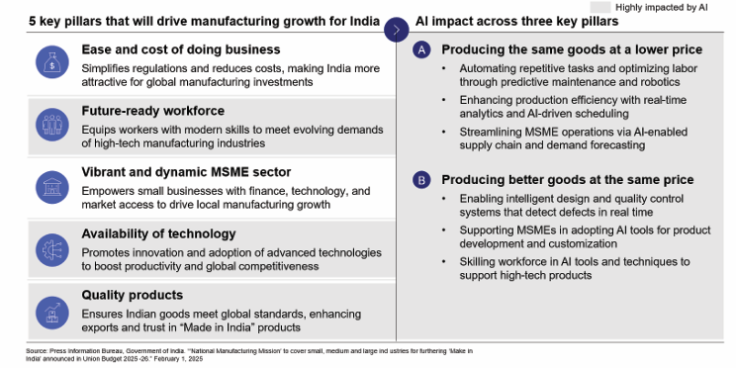

Slide 20
Software assisted vehicles
Software-Assisted Vehicles (SAVs) represent the next generation of automobiles, where core functionalities are increasingly driven by software rather than hardware-intensive systems.
SAVs operate across five defined levels of autonomy, as per the Society of Automotive Engineers (SAE) International.
The automotive industry in India is presently concentrating its efforts on progressing from Level 2, which features partial vehicle autonomy, towards achieving Level 4, characterized by highly autonomous driving capabilities.
These vehicles rely on flexible electronic architectures, connected systems, and over-the-air (OTA) updates to minimize human intervention. India is expected to reach Level 3 by 2035, with its AI-led automotive inflection point between Levels 3 and 4.
As India emerges as a major SAV consumer market and global production hub, this shift offers a key opportunity for domestic value creation and global competitiveness.
By 2035, 40-50% of the total 40-45M vehicle market, i.e. 18-20M units, would be enabled via software (Exhibit 12). These will be split across passenger vehicles at 4-5M, commercial vehicles at 1-2 M and two-wheelers at 13-15M. India could unlock $6-8B cumulative domestic value through AI-enabled SAV domestic subscriptions by 2035, with an estimated $1.5-2B annual exit value that year.

Slide 21
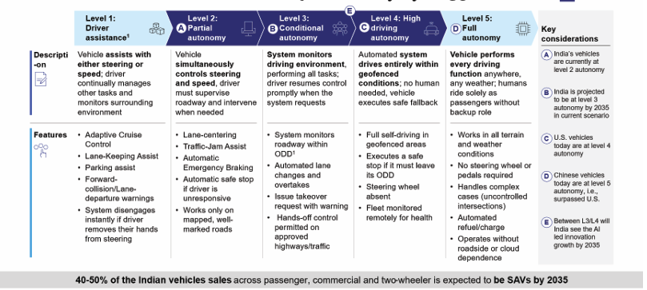

Slide 22
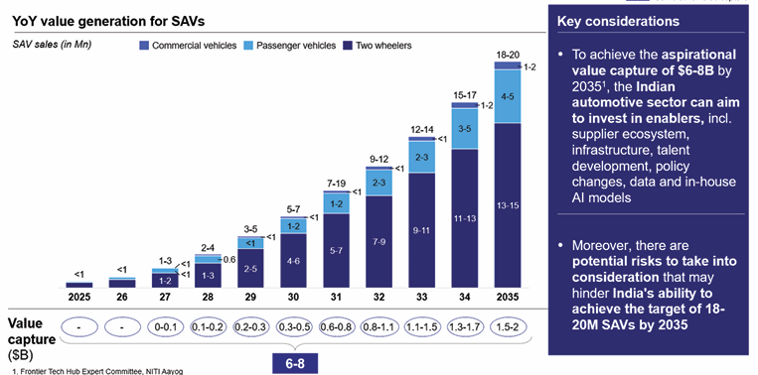

Slide 23
Unlocking opportunities beyond conventional technologies
Conventional autonomous driving relies on costly on-board sensors like LiDAR, cameras, and radars combined with real-time AI processing to navigate roads without human input. However, such systems may face challenges in India due to weather or traffic conditions and poor road markings.
India can explore alternate, infrastructure-assisted approaches to enable affordable and reliable autonomy, including:
RFID-based corridors that help vehicles localize accurately in all weather, reducing reliance on GPS or cameras
Magnet marker guides lanes, which act like a virtual rail, enabling lane-keeping, even on waterlogged roads
5 G-enabled corridors that share real-time data over 5G, helping vehicles detect hidden traffic in urban settings
Satellite navigation system in combination with real-time kinematic from ground towers provides centimeter-level accuracy ideal for remote area

Slide 24
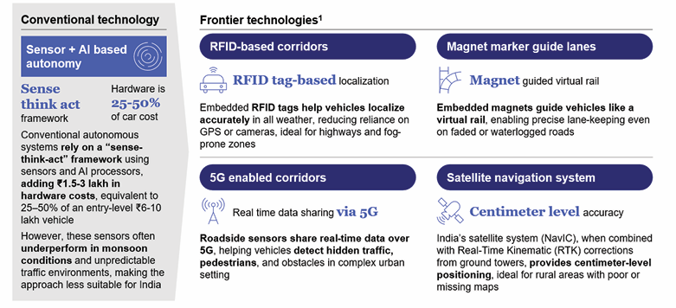
To unlock $6-8B in SAV value over the next decade, AI can help accelerate engineering capability building and faster time to market for software-enabled automotive products at reduced costs. AI copilots or custom LLMs trained on AUTOSAR/ vehicle OS documents can cut learning time by 30–50%. AI-powered model-based design can reduce design cycle times by 20–30%, while AI-led bug detection and regression testing can lower validation costs by up to 40%. Additionally, AI vision and reinforcement learning cn optimize component assembly and reduce Electronic Control Unit (ECU) testing costs.

